Slide 1
WELCOME TruBlue!
An introduction to MAXIMUM Call Center
Notes:
Welcome

Slide 2
HISTORY
MAXIMUM opened its doors on June 1, 1990
Founded on one solid principle - Integrity
Dedicated to customer service
Fully backed by an Uninterruptible Power Supply (UPS) generator backup that is monitored 24 hours a day
Linux based servers with full data backups each night that are stored off site for safety
Phone lines that use the newest stable sophisticated switching technology, to bring you the best pricing with the most stable features.
Notes:
MAXIMUM has been in business for 30 years, always dedicated to customer service. We are supported with an uninterruptible power supply generator that is monitored 24/7, so there is never an instance where we lose power, so we are always there to answer your calls. We use Linux based servers that are backed-up every night at a separate site for safety. WE WILL ALWAYS HAVE YOUR DATA! We use a sophisticated switch so that callers can not tell that the call is being switched to a virtual office. We answer your phones and train our agents to speak as if we are in your office and a part of your team.

Slide 3
CUSTOMERS
MAXIMUM supports hundreds of companies across the country in various industries!
Medical Offices
Home Health Care Franchises
Real Estate – Emergency Maintenance Dispatch & Rental Processing
Legal Offices – Virtual Receptionist & New Client Intake
Accident reporting for trucking industry
Mail Order – For Both Internet, Brick & Mortar Retailers
Credit Card Processing & Customer Service
AND many more!
Notes:
MAXIMUM supports hundreds of companies across the US in several different industries. We are also the corporate call center for Caring Transitions and Home Helpers and we also facilitate the scheduling center for several Fresh Coat and TruBlue franchises. Our agents are professionally trained to handle all sorts of business professional variations from doctors, hospitals, home health, franchises, Broker/Realtors, attorneys, financial planning institutions, order entry, maintenance, residential and commercial services and accident reporting.

Slide 4
WHY USE A LIVE CALL CENTER?
24-hour point of contact ensures you never miss a client and makes a great first impression.
Present a professional, large company image for just pennies on the dollar – typically less than 10% of the cost for a full-time employee.
Since MAXIMUM provides the service to Franchisees across the country, costs are minimal, new setup is a cinch and our staff already has the training to support your clients.
We make it a point to know your business inside and out, allowing us to translate “potential” into “confirmed” business.
Notes:
People want to speak with another live person. When clients are left to leave a message on a voicemail or a machine answers, they don’t get the personal attention they deserve. It can leave clients feeling like they are not as important, and we don’t want that. By having our trained agents field calls when you are not available you are presenting a professional, large company with a fully backed staff. Not to mention our services are typically les than 10% of paying a full time employee. Since we are already versed in everything Franchise related, set-up is simple, cost is minimal and our agents are already trained to support your clients. We make it a point to know TruBlue inside and out to assist each franchisee in turning potential business to confirmed.

Slide 5
PEOPLE BUY FROM PEOPLE!
U.S. based live agents will answer for you 24 hours a day, 7 days a week, 365 days a year! No prospective clients are lost, no calls are missed, and no clients are frustrated because they cannot get the help they need.
TruBlue CSR RESPONSIBILITIES:
Potential customer intake
Schedule in-home quote
Manage calendar for cancellations & reschedules
Marketing Information such as; where they heard about your franchise, etc.
Direct to your website & FAQ’s
Help achieve TruBlue principles, the cure-all for home maintenance!
Notes:
Our agents are proficient in potential client intake, finding out how they heard about “us” and what is the pertinent information you need to make this potential client a confirmed client. We can schedule call backs, give brief, concise marketing information and answer any FAQ’s directly from your website. Our agents have execute buttons within your script to take them straight to your published information so that we can be knowledgeable when speaking. We believe that our approach will in turn assist TruBlue franchisees in achieving Better Busines practices and Total House Care.

Slide 6
CALL BRANCHING OPTIONS
Scripts are custom built to your specifications so that they suit TruBlue business needs, giving you ultimate control over the calls.
Some options include...
Answer questions for the caller
Schedule in-home quotes
Patch the caller with you directly
Take a message for you
Notes:
Scripts are built to your specifications. We cater to your individual needs so that you can cater to your client needs. If at any time you don’t like the way a script is flowing, we can change it. If you have something you need to add for the month, such as promotions or specials you are running for a short or long period, we can add it. We have the ability to patch the caller directly to you, or take a message, whichever you prefer.

Slide 7
CUSTOM MESSAGE OPTIONS
MAXIMUM will build your script to capture only the information YOU need.
This can include; but is not limited to....
Caller's name
Caller's relationship to you (example: potential client, current client, jobseeker ect.)
Phone number
Email Address
Physical location
How they heard about you
Message
Notes:
Custom message options including name, number, email address, physical location, how they heard about us and their message. You can add or remove anything.

Slide 8
Lead Generator Options
If you choose to use a lead generation service, such as Thumbtack, we have call intake options including:
Gathering the information and connecting to the office/scheduler.
Gathering the information, paging and/or emailing the office/scheduler.
Gathering the information and processing the lead. Agent dials out to the customer and schedules the estimate, in your calendar.
Notes:
Explain how we process leads.

Slide 9
Information Captured, Specified to your needs:
Workiz Login information (if scheduling)
Schedule In-Home Quote (day of the week & hour specifications)
Phone Quote (only if refused in-home quote)
Speak with Estimator (to talk about estimate, or haven’t received it via email)
Appointment or Job Cancel/Reschedule
Potential Employee
Speak with Office (catch-all, vendors, no sales calls)
Urgent (situations arising that day only)
Info/FAQ (direct execute button to your website)
Detailed information about the job is sometimes needed. You can determine how in depth our agents get information from the caller, depending on if we are scheduling on your behalf.
Notes:
If MAXIMUM will be doing your scheduling we will need your Workiz account log-in information, or whatever schedule system you use. I believe that most everyone is using Workiz throughout the TruBlue franchise.

Slide 10
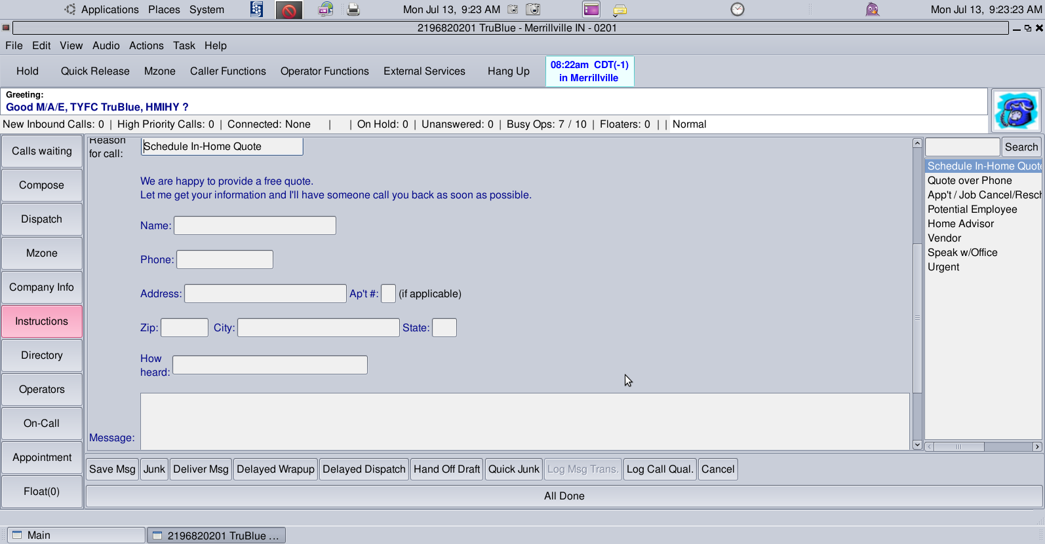
TruBlue SCRIPT EXAMPLE
Choosing “Current Client" automatically inserts the person the message is sent to and contact preference for this type of call
The script will send you information based on your specifications.
Notes:
This is a sample of the account for TruBlue as a whole. Your specialized individual accounts can be set up to your specifications. If there are any specials going on, always let us know and it can be added to script.

Slide 11
Website scheduler sample
We can schedule appointments directly through your website. That information is then linked in with your Workiz software.

Slide 12
Customized messaging sample
To : Dispatch 4250
In-Home Quote
Other
Source: weekly paper in June
Kenneth Greenberg
7046091788
4723 Carberry Court
28226 CHARLOTTE NC
kgreenberg1977@bellsouth.com
Potential customer would like an exterior estimate to have the deck cleaned and stained. They would also like a full list of all of the other services we offer. Please call back to schedule and discuss.
Always set to your TruBlue specifications!
Notes:
Customized messaging options. (Read aloud)

Slide 13
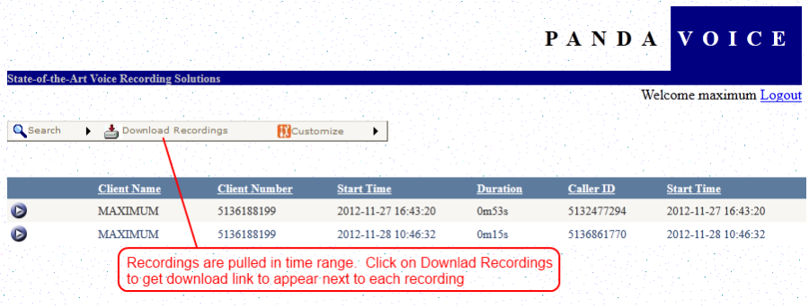
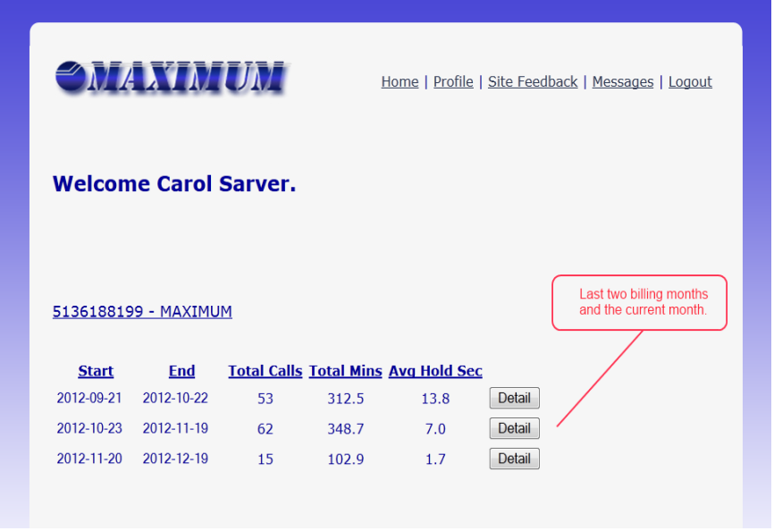
CALL MONITORING OPTIONS
Instantly play back calls
Listen to your calls anywhere at anytime!
Call statistics online
Keep track of your minutes with online reporting.
Includes call date, time, length of call, patch minutes, summaries, and MORE!
Notes:
You have the ability to log into our intranet system and listen to all of your calls. We record everything! So nothing is ever missed and can always be listened to for refreshing. You will be issued your own log in name and password.

Slide 14
PRICING
$32.95 / month
$0.90 per agent minute
$4.95 line charge
One-time set up fee of $25
Monthly / Starter Package
(This is pricing for a basic account structure, text messaging and emails included. No call-outs to the client. Please inquire about detailed pricing for extra services including scheduling packages.)
Notes:
This is TruBlue pricing only! $29.95 a month, .85 cents per agent min, $4.95 line charge, one-time set up fee of $25. This is pricing for a basic account structure, text messaging, and emails included. No call-outs to the client. Please inquire about detailed pricing for extra services. If you are using the Workiz scheduling system it is $14.95 per month for our agents to schedule appointments and maintain the calendar. If you would like to utilize our internal Call linx calendar it is $ 4.95 per month. If you would like information on packages please sent an email or call in.

Slide 15
PRICING
$52.95 / month & includes 60 minutes of agent time
$0.90 per agent minute over the included 60 minutes
Web based scheduling: $14.95 per appointment book, per month
One-time set up fee of $75
Messaging/CRM Package Pricing
Notes:
This is TruBlue pricing only! $29.95 a month, .85 cents per agent min, $4.95 line charge, one-time set up fee of $25. This is pricing for a basic account structure, text messaging, and emails included. No call-outs to the client. Please inquire about detailed pricing for extra services. If you are using the Workiz scheduling system it is $14.95 per month for our agents to schedule appointments and maintain the calendar. If you would like to utilize our internal Call linx calendar it is $ 4.95 per month. If you would like information on packages please sent an email or call in.

Slide 16
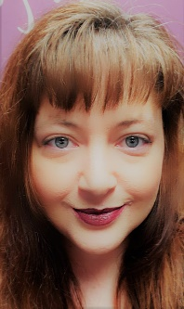
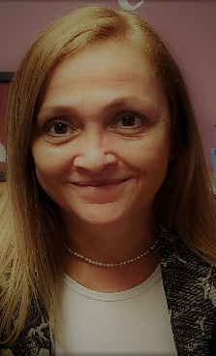
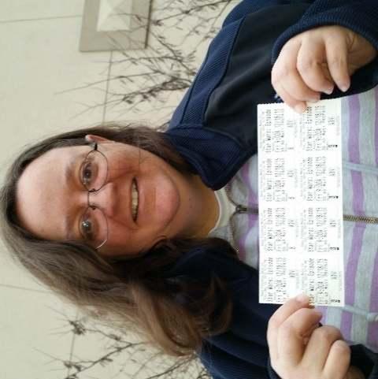
MAXIMUM
Appointment Setting Team
Julie Moore
Appointment Setter/
Emerging Business Development
Carol Sarver
MAXIMUM Account Representative/Owner
Kristine Pierce
Director of Operations
Notes:
Team:
Julie Moore – Appointment Setter/Emerging Business Development
Carol Sarver – Owner
Kristine Pierce – Operations Manager

Slide 17
MAXIMUM Appointment Setting Benefits
Using MAXIMUM to set your appointments will…
Give you the freedom to setup your new business, without worrying about missed connections within your territory!
The Appointment Setters will schedule your appointments FOR YOU, using YOUR calendar.
You provide the “HIT LIST” and we take it from there.
Obtaining local contact information for your appointment.
Multiple contact with business professionals in your territory.
Emailing of personalized templated information about TruBlue upon request.
24-7 Fully Trained Agent support for returned calls from contacts. This ensures that you never miss a contact opportunity.
“Cold calling is a numbers game.
It takes a large number of calls to get the desired result.”
Notes:
Appointment Setting
The appointment setting program is structured to build solid Business Referral Partnerships. Cold calling is a numbers game and you have to be in the right mindset. I schedule these appointments for you, using your calendar. I send out appointment confirmations to your client as well and facilitate all meeting inquiries. My technique is being professional, yet persistent. Kindness goes a long way when calling people out of the blue. I like to cultivate a relationship with the gatekeeper in order to gain access to person we need to talk to. We also offer Previous customer re-activation Outbound Campaigns designed to score that returning business. This has proven to be very beneficial for several of our service industry accounts. Please send an email to get further information.

Slide 18
Compiling your “HIT LIST” & Format
Information needed for each contact is as follows and in this order:
Business name
Website
Address
City
State
Zip
Phone
First name (if available)
Last name (if available)
Title
Email address (if available)
Any special comments you may have
Notes:
Hit list
Compile your Hit List list to start off with. The more information you give me, the better result. I research every contact to the fullest on the web as to learn as much as I can about them to determine what their need is and tell them how having a TruBlue franchise as a Referral Partner can help their business and Vise Versa. I schedule physical appointments along with Zoom virtual meetings and good old fashioned phone calls, whichever the contact prefers.

Slide 19
Your Calendar - Your Appointments
When you share your calendar with the Appointment Setting Team we are able to schedule for you, around your established schedule. You will be guided on sharing your calendar. Please remember it always has to be on “can edit” in order to put appointments directly on your calendar.
Appointments can be cancelled and rescheduled through the appointment setter at any time, in case of conflicts. (Please remember to keep you calendar updated with ALL business and personal appointments.)
All appointments are sent to the contact as well, so you know whom you will be contacting, their phone number and where to go once you arrive.
Notes:
Calendar – sharing your calendar is easy, just make sure it is in the “can edit” view. I have the ability to look at several calendars at once. Appointments can always be canceled and rescheduled at your request if there are any conflicts. By placing your personal and business appointments in your calendar it should assure that doesn’t happen often.

Slide 20
Contact information
MAXIMUM Communications, Inc.
117 Williams Street
Cincinnati, Ohio 45215
(513) 618-8199
www.maximumcommunications.com
service@maximumcallcenter.com
Emerging Business Development
Julie Ann Moore
(513) 618-5114
jamoore@maximumcallcenter.com
sales@maximumcallcenter.com
Owner
Carol Sarver
(513) 618-8199
sarver.carol@gmail.com
Notes:
Contact information

Slide 21
THANK YOU FOR COMING TODAY!
Notes:
Thank you! The end!
I will be sending all of you a follow-up email that contains a set up sheet. Make sure that you put your name under client name and your corporate business name should be TruBlue of _________ DBA ___________ (legal name for billing and tax purposes).

